Slide 1
8. Unsupervised Learning (II)
IT 348/448

Slide 2
Topics
Clustering
Hierarchical Approach

Slide 3
Hierarchical Clustering

Slide 4
Types of Hierarchical Clustering
Agglomerative Hierarchical Clustering
Divisive Hierarchical Clustering

Slide 5
Agglomerative Hierarchical Clustering
Uses a bottom-up approach
Starts by letting each object form its own cluster
Iteratively merges clusters into larger clusters
Until all objects are in a single cluster, or
Until certain termination conditions are satisfied

Slide 6
Divisive Hierarchical Clustering
Uses a top-down approach
Starts by placing all objects in one cluster
Divides the cluster into several subclusters
Recursively partitions those clusters into smaller clusters
The partitioning process continues
until each cluster has only one object, or
The objects within a cluster are sufficiently similar to each other

Slide 7
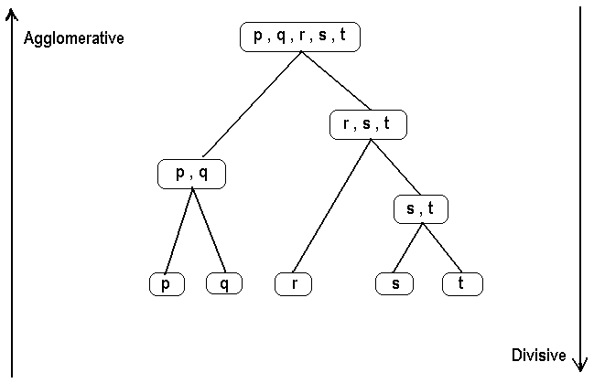
Hierarchical Clustering: Two ways of building hierarchical clusters – Agglomerative versus Divisive Approaches. The Agglomerative Approach starts with each case making up its own cluster and then forming more and more aggregative clusters one step at a time. The Divisive approach starts with all cases in one cluster and then breaks this comprehensive cluster into a succession of smaller and smaller clusters.

Slide 8
Steps in Agglomerative Clustering
Start with n clusters (each observation = cluster)
The two “closest” observations are merged into one cluster.
At every step, the two clusters that are “closest” to each other are merged. That is, either single observations are added to existing clusters or two existing clusters are merged.
This process continues until all observations are merged into one cluster. A graph called the Dendrogram summarizes this process.

Slide 9
Dendrogram
This is a tree-like diagram that summarizes the process of clustering.
For any given number of clusters
we can determine the records in the clusters by sliding a horizontal line (ruler) up and down the Dendrogram until the number of vertical intersections of the horizontal line equals the number of clusters desired.

Slide 10
The Dendrogram of Hierarchical Clustering

Slide 11
Dendrogram: Shows How Clusters are Merged

Slide 12
Three Different Distance Measures Used in Hierarchical Clustering
Minimum distance (single linkage)
Maximum distance (Complete linkage)
Group Average (Average Linkage)
See a geometric representation of these distance measures in the following 3 slides

Slide 13
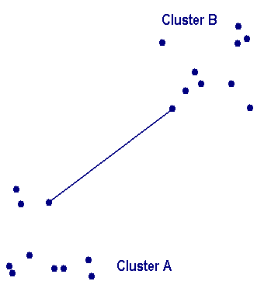
Minimum Distance (Single Linkage)
Single link: smallest distance between an element in one cluster
and an element in the other, i.e., dist(K_{i}, K_{j}) = min(t_{ip}, t_{jq})

Slide 14
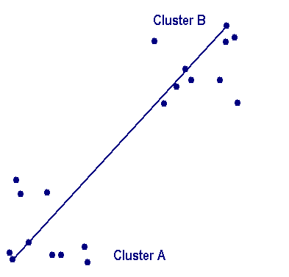
Maximum Distance (Complete Linkage)
Complete link: largest distance between an element in one cluster and an element in the other, i.e., dist(K_{i}, K_{j}) = max(t_{ip}, t_{jq})

Slide 15
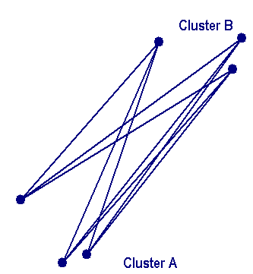
Group Average (Average Linkage)
Average: avg distance between an element in one cluster and an element in the other, i.e., dist(K_{i}, K_{j}) = avg(t_{ip}, t_{jq})

Slide 16
Summary: Distance between Clusters
X
X
Single link: smallest distance between an element in one cluster and an element in the other, i.e., dist(K_{i}, K_{j}) = min(t_{ip}, t_{jq})
Complete link: largest distance between an element in one cluster and an element in the other, i.e., dist(K_{i}, K_{j}) = max(t_{ip}, t_{jq})
Average: avg distance between an element in one cluster and an element in the other, i.e., dist(K_{i}, K_{j}) = avg(t_{ip}, t_{jq})
Centroid: distance between the centroids of two clusters, i.e., dist(K_{i}, K_{j}) = dist(C_{i}, C_{j})
Medoid: distance between the medoids of two clusters, i.e., dist(K_{i}, K_{j}) = dist(M_{i}, M_{j})
Medoid: a chosen, centrally located object in the cluster
16
Notes:
16

Slide 17
Hierarchical Clustering
Use distance matrix as clustering criteria. This method does not require the number of clusters k as an input, but needs a termination condition
Step 0
Step 1
Step 2
Step 3
Step 4
agglomerative
(AGNES)
a
a b
b
a b c d e
c
c d e
d
d e
e
divisive
(DIANA)
Step 4
Step 3
Step 2
Step 1
Step 0

Slide 18
AGNES (Agglomerative Nesting)
Introduced in Kaufmann and Rousseeuw (1990)
Initially: each object is a cluster (leaf)
Use the single-link method and the dissimilarity matrix
Recursively merges nodes that have the least dissimilarity
Criteria: min distance, max distance, avg distance, center distance
Eventually all nodes belong to the same cluster

Slide 19
DIANA (Divisive Analysis)
Inverse order of AGNES
Start with root cluster containing all objects
Recursively divide into subclusters
Eventually each node forms a cluster on its own

Slide 20
Major weakness of agglomerative clustering methods
Do not scale well:
Time complexity of at least O(n²), where n is the number of total objects
Dendrograms are most useful when there a small number of observations (cases) to cluster.

Slide 21
Limitations of Hierarchical Clustering
The Agglomerative procedure works for larger data sets
but is computing intensive in that (nxn) matrices are the basic building blocks for the Agglomerative procedure.
Can never undo what was done previously
Hierarchical Clustering only makes one pass through the data. Therefore, early clustering decisions affect the rest of the clustering results

Slide 22
Limitations of Hierarchical Clustering (cont.)
Hierarchical Clusters often have low stability. That is, adding or subtracting variables or adding or dropping observations can affect the groupings substantially.
The determination of final clusters can be sensitive to outliers and their treatment.

Slide 23
Readings
Geron, Chapter 9
Clustering_Analysis
/Readings/ in Canvas

